Slide 1


Chapter 7
Managing CPUs for a Virtual Machine
Virtualization Essentials

Slide 2
Chapter 7 Objectives
Understand how virtual machines use CPU resources
Configure CPU resources in a virtual machine
Examine some CPU tuning practices
Understand how hyperthreading works with virtualization
2

Slide 3
Virtual CPUs
CPU (central processing unit)
Computer inside the computer
CPU uses instruction set plus data to perform calculations
CPU performance is a measure of work being done, rather than instructions per second
3

Slide 4
Scheduling Time on a CPU
Virtualizing a CPU is actually the hypervisor scheduling slices of time on the physical CPU (pCPU)
1 virtual CPU (vCPU) = 1 physical core though vCPUs are not mapped to pCPUs
4

Slide 5
Cores and Processors
# of Processors | Single Core | Dual Core | Quad Core
1 | 1 | 2 | 4
2 | 2 | 4 | 8
4 | 4 | 8 | 16
8 | 8 | 16 | 32
Today’s CPUs come in packages that contain multiple processors
Each processor is also called a core
When planning for resources, virtual CPUs can be roughly mapped to a single physical core
5

Slide 6
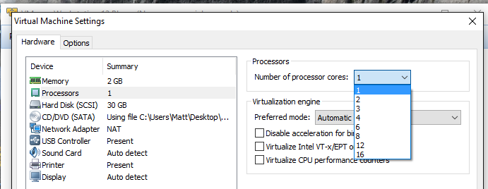
Configuring Virtual CPUs
Only the amount of vCPUs can be adjusted
Additional vCPUs can be hot-added with some operating systems (Linux, Server 2008 R2)
Different platforms support different numbers of vCPUs in a VM
6

Slide 7
vCPUs and pCPUs
When sizing a virtualization host, since a single pCPU is not 100% busy (the reason for consolidation), one pCPU can service multiple vCPUs
Follow vendor recommendations but understand the workloads
In a four-processor quad-core system, at 1:1, 16 vCPUs can be configured
The same system, at 5:1, 80 vCPUs, 10:1 would be 160 vCPUs
7

Slide 8
Multiprocessor Virtual Machines
A virtual machine with multiple vCPUs needs to schedule time on multiple pCPUs
Additional vCPUs might hinder performance depending on many factors including physical resources and CPU contention
Best practice is to configure one vCPU to a new virtual machine and increase the number if needed, rather than start higher and decrease the amount
It is also possible to create multiprocessor, multicore VMs
Equivalent in performance to multiple single-core vCPUs in capability but sometimes done for licensing reasons
8

Slide 9
Hyperthreading
Hyperthreading is an Intel technology that provides better CPU utilization
Can be used with virtual machines
Provides up to an additional 30% of performance per CPU, though it appears to double the amount of CPUs
Two prerequisites
The operating system must support multiple processors
The operating system must support hyperthreading
Hypervisors can also use hyperthreading
9

Slide 10
Intel and AMD Processors
Both Intel and AMD x86 chipsets work well for virtualization
Virtual machines can be moved from an Intel server to an AMD server, but it must be shut down first
This is because the command set of the chips are different
A virtual machine can only be live migrated to a server that has the same chipset (Intel-to-Intel or AMD-to-AMD)
Clusters are usually one type of chipset because of this
10

Slide 11
Chapter 7 Summary
Virtual machines use scheduled time on the physical processors of their host
Virtual machines can have one or more vCPUs
Multiple vCPUs are not always preferable
Poor configurations can magnify performance issues
Virtual machines can use hyperthreading
11

